Slide 1
Understanding Cosmos Consistency Levels

Slide 2
Understanding Cosmos Consistency Levels
Goal
Understand
Cosmos Consistency Levels
&
Implications

Slide 3
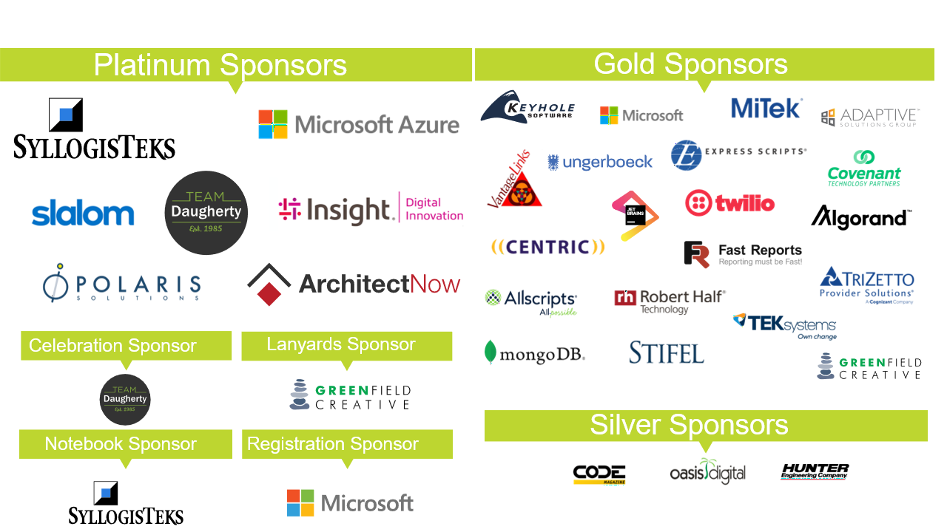

Slide 4













Understanding Cosmos Consistency Levels
Agenda

Slide 5































What is Cosmos?

Slide 6































What is Cosmos?

Slide 7
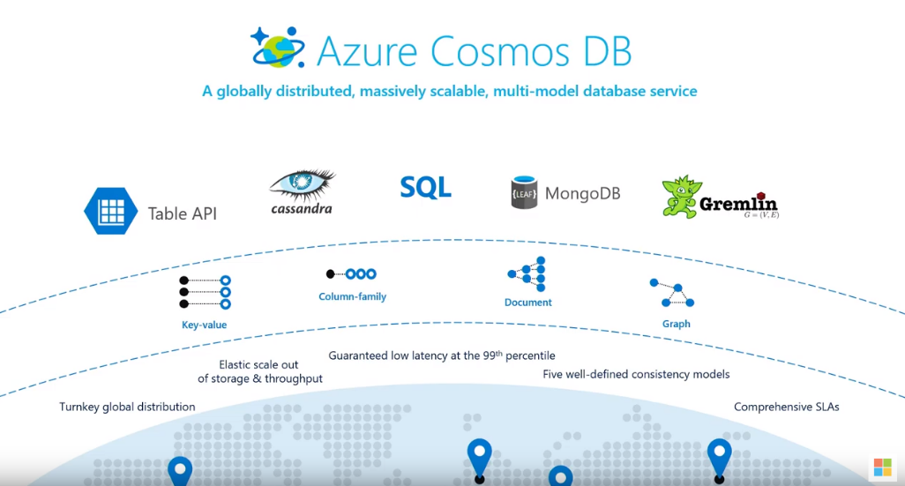
Cosmos Multi-Model

Slide 8
CAP Theorem
Consistency
It is impossible for a distributed data store to simultaneously provide more than two out of the following three guarantees:
Availability
Partition
https://en.wikipedia.org/wiki/CAP_theorem

Slide 9
PACELC
In case of network partitioning (P) in a distributed computer system, one has to choose between availability (A) and consistency (C) (as per the CAP theorem), but else (E), even when the system is running normally in the absence of partitions, one has to choose between latency (L) and consistency (C).
https://en.wikipedia.org/wiki/PACELC_theorem

Slide 10


























PACELC
Network is
not working
Network is working

Slide 11





















RPO & RTO

Slide 12







RPO & RTO

Slide 13
























RPO & RTO

Slide 14
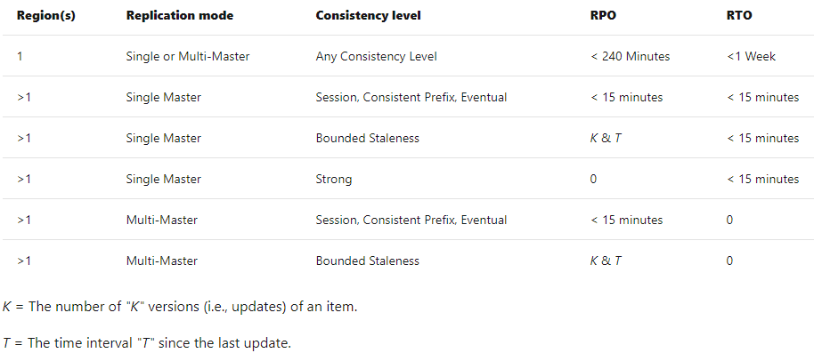






RPO & RTO
https://docs.microsoft.com/en-us/azure/cosmos-db/consistency-levels-tradeoffs

Slide 15



Local Replication
Leader
Replicas in a Region
Follower
Follower
Forwarder

Slide 16




















Fault Domains
Leader
Follower
Follower
Forwarder

Slide 17
Physical Partitions
Leader
Leader
Leader
Follower
Follower
Forwarder
Follower
Follower
Forwarder
Follower
Follower
Forwarder
Physical Partitions

Slide 18



Geo-Replication
Leader
West US 2
Follower
Follower
Forwarder
East US 2
Leader
Follower
Follower
Forwarder

Slide 19








Partition Sets
Leader
Leader
Leader
Follower
Follower
Forwarder
Follower
Follower
Forwarder
Follower
Follower
Forwarder
Leader
Leader
Leader
Follower
Follower
Forwarder
Follower
Follower
Forwarder
Follower
Follower
Forwarder

Slide 20
General Consistency Levels
Strong
Eventual Consistency

Slide 21



Cosmos Consistency Levels
Strong
Session
Eventual Consistency
Bounded Staleness
Consistent Prefix

Slide 22








Cosmos Consistency Levels
Strong
Session
Eventual Consistency
Bounded Staleness
Consistent Prefix

Slide 23
Strong – Bounded Staleness – Session – Consistent Prefix – Eventual Consistency
Single Region
*MAY* read data not-yet-updated
Client
Application
Leader
Follower
Follower
Forwarder
Client
Application

Slide 24

Strong – Bounded Staleness – Session – Consistent Prefix – Eventual Consistency
Primary Region
Secondary Region
Leader
Leader
Follower
Follower
Forwarder
Follower
Follower
Forwarder
*MAY* read data not-yet-updated
Client
Application
Client
Application

Slide 25

































Strong – Bounded Staleness – Session – Consistent Prefix – Eventual Consistency
Client
Application
Client
Application
Client
Application
Notes:
The scenario is the first client application is updating a document. A value is going from A to B, then to C, then to D. Each are saved updates to the document. All client applications may read at any time. It may get stale data. There is no guarantee which replica it is reading from.

Slide 26






























Strong – Bounded Staleness – Session – Consistent Prefix – Eventual Consistency

Slide 27



























Strong – Bounded Staleness – Session – Consistent Prefix – Eventual Consistency

Slide 28





















Strong – Bounded Staleness – Session – Consistent Prefix – Eventual Consistency
Client
Application
Client
Application
Notes:
The scenario is the first client application is updating a document. A value is going from A to B, then to C, then to D. Each are saved updates to the document. The second client application may read at any time. It may get stale data but never out of order.

Slide 29

Strong – Bounded Staleness – Session – Consistent Prefix – Eventual Consistency
Client
Application
Notes:
The scenario is the first client application is updating a document. A value is going from A to B, then to C, then to D. Each are saved updates to the document.

Slide 30







Strong – Bounded Staleness – Session – Consistent Prefix – Eventual Consistency
Client
Application
Notes:
As the client application is writing and reading, it is reading its own writes. It is guaranteed to read the updated data it just wrote.

Slide 31























Strong – Bounded Staleness – Session – Consistent Prefix – Eventual Consistency
Client
Application
Client
Application
Notes:
But other client applications may read stale data (never out of order).

Slide 32





























Strong – Bounded Staleness – Session – Consistent Prefix – Eventual Consistency
Notes:
Although the Cosmos DB system replicates data as quickly as possible (there is no latency added intentionally), there is no guarantee when the replicas are all in sync. This applies to Eventual, Consistent Prefix, and Session.

Slide 33

















Strong – Bounded Staleness – Session – Consistent Prefix – Eventual Consistency
Notes:
With Bounded Staleness and Strong, the stale data window is governed.

Slide 34

































Strong – Bounded Staleness – Session – Consistent Prefix – Eventual Consistency
Notes:
With Bounded Staleness the window of stale data is governed by T (Time) and K (# Ops). The T & K min and max differ if using a single region or multiple regions.

Slide 35


















Strong – Bounded Staleness – Session – Consistent Prefix – Eventual Consistency
Notes:
With Bounded Staleness the window of stale data is governed by T (Time) and K (# Ops). The T & K min and max differ if using a single region or multiple regions.

Slide 36



























Strong – Bounded Staleness – Session – Consistent Prefix – Eventual Consistency
Notes:
Note that the T & K values have an affect on RPO when using multi-master.

Slide 37
Strong – Bounded Staleness – Session – Consistent Prefix – Eventual Consistency
Leader
West US 2
Follower
Follower
Forwarder
East US 2
Leader
Follower
Follower
Forwarder
Notes:
When replicating to other regions, the Forwarder replica sends data to the Leader replica in the other regions. This is done concurrently. If there are 3 regions then the data is replicated to the other regions at the same time, not sequentially. Also note, the latency is based on the longest distance between the master and the replica furthest away.

Slide 38







Strong – Bounded Staleness – Session – Consistent Prefix – Eventual Consistency
Leader
West US 2
Follower
Follower
Forwarder
East US 2
Leader
Follower
Follower
Forwarder

Slide 39

Strong – Bounded Staleness – Session – Consistent Prefix – Eventual Consistency
Leader
West US 2
Follower
Follower
Forwarder
East US 2
Leader
Follower
Follower
Forwarder
Notes:
All consistency levels use snapshot isolation. What is shown here is a read that is occurring just before a write has committed. The read returns the latest known data. Once the write commits then the data version is changed and all subsequent reads now get that new data.

Slide 40

Strong – Bounded Staleness – Session – Consistent Prefix – Eventual Consistency
Leader
West US 2
Follower
Follower
Forwarder
East US 2
Leader
Follower
Follower
Forwarder

Slide 41



Strong – Bounded Staleness – Session – Consistent Prefix – Eventual Consistency
Leader
West US 2
Follower
Follower
Forwarder
East US 2
Leader
Follower
Follower
Forwarder

Slide 42























Strong – Bounded Staleness – Session – Consistent Prefix – Eventual Consistency
Client
Application
Client
Application
Notes:
In this scenario, the client application is writing an update to a document. The value goes from A to B, then to C, then to D. This shows all client applications read the latest committed data.

Slide 43
Replicas -> Majority = 3 && Minority == 2
Consistency Level | Quorum Reads | Quorum Writes
Strong | Local Minority (2 RU) | Global Majority (8 RU)
Bounded Staleness | Local Minority (2 RU) | Local Majority (8 RU)
Session | Single replica using session token(1 RU) | Local Majority (8 RU)
Consistent Prefix | Single replica (1 RU) | Local Majority (8 RU)
Eventual | Single replica (1 RU) | Local Majority (8 RU)
Notes:
This shows which replicas are used during reads and writes based on consistency level. Note that Strong writes use global majority. This has latency impact when using multiple regions.

Slide 44











Multi-Region Write Enabled “Multi-Master”
Client
Application
Leader
West US 2
Follower
Follower
Forwarder
East US 2
Leader
Client
Application
Follower
Follower
Forwarder
Notes:
Now using multiple regions with multiple masters. This shows that the Forwarder in each region is replicating data to the other region(s). This example also shows low latency for each client application.

Slide 45





























Multi-Region Write Enabled “Multi-Master”
Notes:
Using “Multi-Master” is great for low latency, but, has a down-side. The strongest consistency level that can be used is Bounded Staleness. This means there is an RPO window. The smallest amount of time is 5 minutes of potential data loss. Note, that the recovery time (RTO) is 0. Client applications are automatically redirected to region in the “Preferred Locations” list in the instantiated client connection.

Slide 46























Multi-Region Write Enabled “Multi-Master”
Notes:
With data replicating in mere milliseconds, how can there be data loss up to 5 minutes?

Slide 47




























Multi-Region Write Enabled “Multi-Master”
Notes:
With data replicating in mere milliseconds, how can there be data loss up to 5 minutes?

Slide 48





















Multi-Region Write Enabled “Multi-Master”
Notes:
In an average day, data is replicating to other regions in milliseconds.

Slide 49













Multi-Region Write Enabled “Multi-Master”
Notes:
The problem occurs when a region outage is beginning. The backbone Microsoft network is not available for multi-region data replication. Network hiccups occur frequently but are, relatively, small.

Slide 50



Multi-Region Write Enabled “Multi-Master”
Notes:
Although data cannot be replicated to other regions, the question becomes; at what point should the application (in that region) stop writing data? The smallest timeframe that can be used is 5 minutes. This means that this Cosmos instance will not be told to stop accepting writes until 5 minutes of network (or some other regional failure issue) outage.

Slide 51










Multi-Region Write Enabled “Multi-Master”
Notes:
The potential for data loss comes with the 5 minutes of writes that could not replicate AND the region (or Cosmos instance) completely shuts-off. However, that’s the worst-case condition. If the region starts to recover, then the replicas start to sync. When a Cosmos instance is offline then available, it syncs with the other replicas before becoming available to client applications.

Slide 52



RPO Mitigation
Notes:
One way to mitigate this possible data loss is to use “Custom Synchronization”.

Slide 53
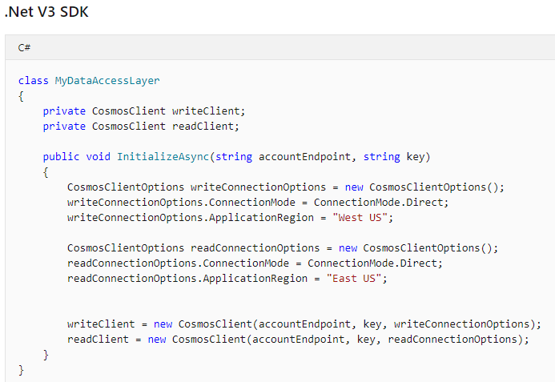
Custom Synchronization
https://docs.microsoft.com/en-us/azure/cosmos-db/how-to-custom-synchronization
Notes:
Custom Synchronization is with the client application. By using 2 client connections, 1 to write and another to read, the client code can respond if a replication fails to occur.

Slide 54
Custom Synchronization
class MyDataAccessLayer
{
public async Task CreateItem(string databaseId, string containerId, dynamic item)
{
ItemResponse<dynamic> response = await writeClient
.GetContainer("containerId", "databaseId")
.CreateItemAsync<dynamic>( item, new PartitionKey("test"));
await readClient.GetContainer("containerId", "databaseId")
.ReadItemAsync<dynamic>( response.Resource.id, new PartitionKey("test"),
new ItemRequestOptions { SessionToken = response.Headers.Session,
ConsistencyLevel = ConsistencyLevel.Session });
}
}
https://docs.microsoft.com/en-us/azure/cosmos-db/how-to-custom-synchronization
Notes:
This example shows a “write client” writing data to one region and receiving a session token. The “read client” uses that session token to read from another region. If the read fails by error or timeout, then the code can decide how to handle the possibility of a region outage.

Slide 55






























Custom Synchronization

Slide 56

















Cosmos Account, Database, and Containers
Account
Database
Container
Container

Slide 57
Cosmos Consistency Levels
Company: Wham-Bam
Products: Fidget Widgets
Notes:
Business case scenario; our fake company Wham-Bam creates Fidget Widgets.

Slide 58
Cosmos Consistency Levels
Purchasing
Manufacturing
Parts
Inventory
Product
Inventory
Sales
Accounting
Shipping
Notes:
This is a manufacturing company with many departments responsible for the sales, creation, and shipping of the products.

Slide 59




Cosmos Consistency Levels
Notes:
Image multiple assembly lines. At the end of each line is a sensor used to keep track of completed products. This is used later in the scenario.

Slide 60
Cosmos Consistency Levels
Receive Purchased Parts
Parts Checked-in
Parts Pulled for Assembly Lines
Parts Sorted to Assembly Lines
Assembly of Product
Quality Testing
Packaging
Product Inventory Update
Shipping Preparation
Shipping Logistics
Shipping Loads Trucks
Notes:
These are just a few of the many activities that occur in the production of our Fidget Widgets. The idea is to consider these business activities. The choice of consistency level is BASED ON ACTION.

Slide 61

Cosmos Consistency Levels
Notes:
The manufacturing company hired a software development firm to help develop a system to track the production of Fidget Widgets. The consistency level to choose is primarily based on why you need the data. Can that question tolerate some amount of stale data?

Slide 62

Cosmos Consistency Levels
How many products are made per line
per hour
right now?
Notes:
What consistency level would you choose when retrieving data to make the answer? How many products are made per line, per hour, right now?

Slide 63
Cosmos Consistency Levels
How many products are made per line
per hour
right now?
Consistent Prefix
Notes:
The boss doesn’t want to stop production to get the absolute most up-to-date answer. But also, the boss cannot receive answers (assuming multiple reads) that are not in order. He didn’t write any data, so Session does him no good. Eventual has the risk of returning correct, but old data, out of order. Why not Bounded Staleness? This shows there are two possible right answers. The real answer more depends on the other real-world reasons to answer the boss’ question.

Slide 64

Cosmos Consistency Levels
As an Accountant
I do double-entry.
I can see the values
I write.
Notes:
In this example, the accountant is merely pointing out that as she updates data she can see exactly what she wrote.

Slide 65
Cosmos Consistency Levels
As an Accountant
I do double-entry.
I can see the values
I write.
Session
Notes:
If she ever received old data than what she just wrote, then the confidence in the system would be very low. “Did the system actually record my change?” “Should I save that change again?”

Slide 66


Cosmos Consistency Levels
How many products
produced, so far, today?
Need most
correct answer?
OR
Need answer
now?
Notes:
We need to answer with how many products are produced, so far, today. However, the reason to answer that question may govern the choice of consistency level.

Slide 67
Cosmos Consistency Levels
How many products
produced, so far, today?
Strong
Need most
correct answer?
OR
Need answer
now?
Bounded Staleness
Notes:
If the “most correct answer” is needed, then imagine having to stop the assembly lines and go one-by-one counting. This adds latency to the production. If, however, you just need the most correct answer known at the moment but allows for possible stale data (in this example the data might be a few minutes old), then Bounded Staleness.

Slide 68

Cosmos Consistency Levels
What about
Eventual Consistency?
Notes:
Now, what business reason can you guess for using Eventual consistency?

Slide 69

Cosmos Consistency Levels
I Know !
Data Analytics !!
Notes:
Reporting or Data Analytics are good examples. The data used (generally) does not require split-second accuracy. Given the extremely low latency Cosmos has with replicating data, Eventual is a good choice for data queries involved in reporting, data analytics, and many others.

Slide 70

Q & A and Thank You!
Sean Whitesell
What questions do
you have for me?
@seanw122
seanwhitesell.com
President of
Tulsa .NET User Group
&&
Cloud Architect @ TokenEx, LLC

